Slide 1
Grief, Loss and Bereavement –
“The Art of the Visit”
Module Two: Supporting a Pronouncement
Alisha Leventis, RN, BScN, MN, CHPCN (c)
Palliative Clinical Coach Windsor-Essex
Acknowledgements:
Grateful appreciation to Maureen Collins, Nancy Adams, Grant Goddard, and Diane Russett for their shared insights
Adapted for use by:
Notes:
Facilitator notes: Recapping from module 1 – shared experience, practice change – bring it back
Share a story from a pronouncement – when creating this module, used the feedback from a family where they felt the pronouncement was “transactional” and “cold” and it left the family feeling like their loved one did not matter.

Slide 2
Compassionate Death Pronouncement: More than a task
Death pronouncement is a pivotal moment in the bereavement process
Clinicians must approach it with skill, sensitivity, and compassion
Prompt examination can convey care and respect
Families value when clinicians act with respect and compassion
Key actions include:
  Introduce yourself and use the patient’s name
  Speak respectfully to the patient like they are still alive during the exam
  Adjust clothing and bedding after examination
Explaining the cause of death and offering reassurance supports family comfort and trust
(Hamano et al., 2023; Mori et al., 2018)
Adapted for use by:
Notes:
Facilitator Notes:
Discuss with the family ahead of time if possible. Is there extra time desired with their loved one? Make sure that family are aware that time is allowed at home prior to calling the funeral home. Notify the funeral home at time of death if family would like more time with their loved one.

Slide 3
The Impact of Compassionate Communication
Compassionate, sensitive communication builds trust and reduces family anxiety
Clear explanations can prevent added trauma and help families adapt to loss
Poor or unclear communication is linked to negative outcomes and may contribute to complicated grief
(Hamano et al., 2023; Mori et al., 2018)
Adapted for use by:
Notes:
Facilitator Notes: Some deaths can feel sudden and unexpected even when expected. Some families may not have planned for funeral arrangements prior to death. This time can be overwhelming and can feel traumatic for the family. Sensitivity and compassion is important!

Slide 4
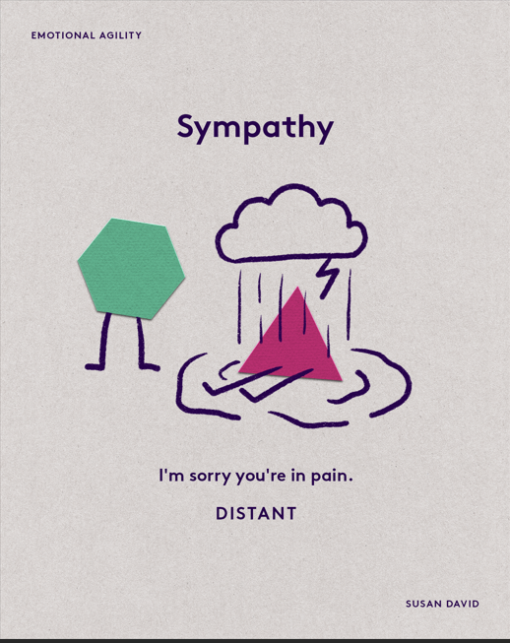
Understanding Sympathy, Empathy and Compassion in communication
Sympathy
    Sharing the feelings of another
    Understanding from your own perspective
    Reflecting on yourself
    Non-emotional
    (David, Susan, 2022)
Adapted for use by:
(David, Susan, 2022)
Notes:
Facilitator Notes: “Noticing” or “Feeling For” or “Looking in”

Slide 5
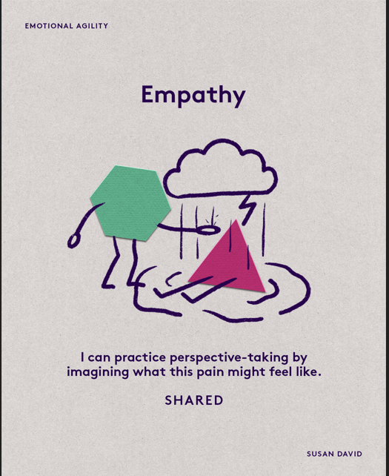
Understanding Sympathy, Empathy and Compassion in communication
Empathy
    Imagining how another feels
    Perspective taking
    Non-judgmental; listening
    Recognizing emotion in another person that you maybe have felt before
    Communicating recognition of the emotion
    (David, Susan, 2022)
Adapted for use by:
(David, Susan, 2022)
Notes:
Facilitator Notes: “Understanding” or “Feeling With”. “Sharing” – feeling something of that yourself – identifying in yourself that emotion or feeling.

Slide 6
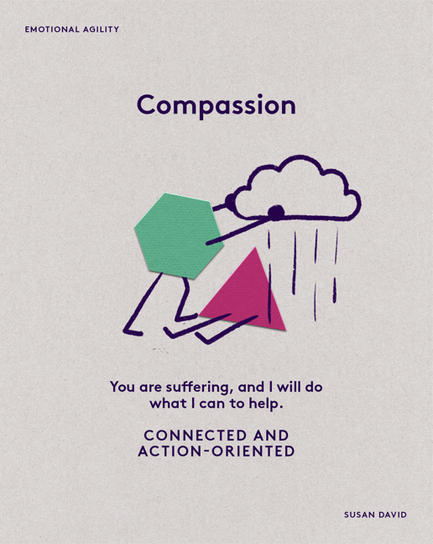
Understanding Sympathy, Empathy and Compassion in communication
Compassion
    Imagining how another feels
    Perspective taking
    Non-judgmental; listening
    Recognizing emotion in another person that you maybe have felt before
    Communicating recognition of the emotion
    Taking action to reduce the suffering of the other
    (David, Susan, 2022)
Adapted for use by:
(David, Susan, 2022)
Notes:
Facilitator Notes: “Supporting” or “Feeling With + an action to help”. Actions can be talking/exploring feelings. Connecting with social work and resources. This is where we need to be as providers. Who are you involving in their care?

Slide 7
Guiding Families through Death Pronouncement
Nurses often enter highly emotional situations where fear and uncertainty are present, yet trust is built from the very first visit
Death pronouncement requires the same calm, compassionate approach
Introduce yourself and remain calm
Gently ask, “Can you tell me what is happening” – listen, assess, and proceed with care
Explain each action as you move through the pronouncement process
Ensure the patient’s dignity is always preserved
Offer to contact others the family may want present
Maintain a steady, reassuring presence
(Churcher & Dowie, 2020; Hamano et al., 2023; Pattison, N. 2008)
Adapted for use by:
Notes:
Facilitator Notes: Check in with yourself/Ground yourself before stepping into the home. Be a “sea of calm” in chaos. Stress importance of explaining each action as you move through – this may be the caregiver’s first experience, they do not know what to expect or what you will be doing during a pronouncement. If possible, explore this earlier with the family – making sure they know what will happen.
Ask at the beginning of the visit – Is there anyone who should be here? Who can support you? Is there anyone you need me to call? *Try not to leave anyone alone*
Ensure families are aware they can participate in care if they wish. Then prior to leaving, ask “Is there anything else you need?”

Slide 8
Supporting Families after Death at Home
This time with their loved one is meaningful – it is the family’s final chance to say good-bye in a familiar setting
Offer guidance about when to call the funeral home and what to expect when they arrive
Fulfill any reporting and documentation requirements per agency policy
If possible, remain until the funeral home attends
Before leaving:
  Sit with the family
  Ask if others need to be notified
  Ensure they understand the next steps and invite any final questions
(Rawlings, Winsall, Yin & Devery, 2022)
Adapted for use by:
Notes:
Facilitator Notes: When contacting the Funeral home, try to do so outside of the room/space with family. Funeral home may be asking practical questions – i.e. size of the patient, door to enter etc.
Provide anticipatory guidance - Review what goes to the funeral home with the patient – pronouncement paperwork; review everyone’s role and what they can do.
FYI – if family ask, funeral home can create letters for banking and assist with some further paperwork.

Slide 9
Key Considerations in Death Pronouncement
Culture and Ethnicity
Family Dynamics – “Past, present and future”
Pronouncements involving children
Adapted for use by:
Notes:
Facilitator Notes: Allow for open discussion – if there is no discussion – can provide below prompts.
Culture and Ethnicity: Never assume that just because a patient identifies with a certain religion means that they believe in the associated beliefs, rituals and practices, there exists considerable variation within religions and individual beliefs of its followers. Knowing the plan is helpful. Some cultural practices can be known prior to the death.
Family dynamics: Share a brief story to draw on audience participation. “Life is messy, death is messy”
Pronouncements involving children: Emotional weight of a pediatric death, care for family’s potential shock response, support for siblings and extended family

Slide 10


Our Learning Journey
Supporting Bereavement
Supporting a Pronouncement
Supporting Anticipatory Grief
Notes:
Animation - Give preview of the next module: Supporting Bereavement. As we finish, the key takeaway is this: understanding the what is important but mastering the how is what drives impact.
Thank everyone and close.

Slide 11
References
Churcher, C. E., & Dowie, I. (2020). How to verify the death of a patient. Nursing Standard. https://doi.org/10.7748/ns.2020.e11561
David, S. (2022, October 12). Sympathy, empathy, compassion. Retrieved from https://www.susandavid.com/resource/sympathy-empathy-compassion/
Hamano, J., Masukawa, K., Tsuneto, S., Shima, Y., Morita, T., Kizawa, Y., & Miyashita, M. (2023). Need for improvement in death pronouncements in palliative care units. Palliative Medicine Reports, 4(1), 350–357. https://doi.org/10.1089/pmr.2023.0053
Mori, M., Fujimori, M., Hamano, J., Naito, A. S., & Morita, T. (2018). Which physicians’ behaviors on death pronouncement affect family-perceived physician compassion? A randomized, scripted, video-vignette study. Journal of Pain and Symptom Management, 55(2), 189–197.e4. https://doi.org/10.1016/j.jpainsymman.2017.08.024
Pattison, N. (2008). Caring for patients after death. Nursing Standard (through 2013), 22(51), 48-56; quiz 58. https://ledproxy2.uwindsor.ca/login?url=https://www.proquest.com/scholarly-journals/caring-patients-after-death/docview/219890212/se-2
Rawlings, D., Winsall, M., Yin, H., & Devery, K. (2022, March 4). How hospital staff say goodbye to dying patients – Evaluation of an online education module: Imminent death. Australian Nursing & Midwifery Journal. https://anmj.org.au/how-hospital-staff-say-goodbye-to-dying-patients-evaluation-of-an-online-education-module-imminent-death/
Adapted for use by:

