Slide 1
Grief, Loss and Bereavement –
“The Art of the Visit”
Module Three: Supporting Bereavement
Alisha Leventis, RN, BScN, MN, CHPCN (c)
Palliative Clinical Coach Windsor-Essex
Acknowledgements:
Grateful appreciation to Maureen Collins, Nancy Adams, Grant Goddard, and Diane Russett for their shared insights
Adapted for use by:
Notes:
Facilitator Notes: Quick recap of the previous two modules. Allow some brief time to invite the group to share any potential practice changes or approaches used – it does not have to be a large change. Allow for shared learning.

Slide 2

Adapted for use by:
Notes:
Facilitator Notes: Grief and love are forever intertwined. Grief is an unending reminder of the depths of our love. They are

Slide 3
Take a moment to reflect…..
Think about a time when you’ve been uncomfortable around someone who is grieving
  What made you uncomfortable?
  How did you handle it?
  Was your response about your discomfort or their distress or both?
Adapted for use by:
Notes:
Facilitator Notes: Think, Pair and Share Opportunity

Slide 4
5 Common Myths about Grief
#1 – Grief and Mourning are the same experience
Grief is the internal thoughts and feelings, and mourning is the outward expression of grief
#2 – There is a predictable and orderly progression to the experience of grief
Grief is neither predictable nor orderly; each person’s grief is uniquely their own
#3 – It is best to move away from grief and mourning instead of toward it
Many people view grief as something to be overcome rather than experienced
#4 – Tears expressing grief are only a sign of weakness
Crying is nature’s way of releasing internal tension in the body – helps people feel emotionally and physically better
#5 – The goal is to “get over” your grief
You never “get over” grief, you reconcile the grief (i.e. live with it)
Adapted for use by:
Notes:
Facilitator Notes: Focus on number 2 - You need to address the person in the world they are living in right now.
Grief never ends; it’s with you forever. If grief continues to be overwhelming and a person can not function – consider complicated grief and help facilitate a referral for additional help.
Red flags for complicated grief – Multiple losses.
Benefits with 1:1 grief counselling and spiritual support
Benefits with shared experiences in group sessions.
It’s not about getting over grief, it’s about reconciling it and putting it somewhere where you can live around it.

Slide 5
Check Yourself
When you are with someone who is grieving, remind yourself: “This is not my grief”
Remain calm and approach with empathy
Before you react (act), take a few moments to reflect, “what might the person need or want in this moment…what might be helpful to them”
Remember you may need to be more patient when speaking to a grieving family member – speak slowly and you may have to repeat yourself
Feelings do not need to be fixed – family and friends may need an opportunity to explore their thoughts and feelings
(Canadian Virtual Hospice, n.d.)
Adapted for use by:
Notes:
Facilitator Notes: Bring back module two – How do we show compassion?
Focus on addressing them “in the world they live in right now”
As healthcare providers we carry “witnessed grief” but not the “depth of love grief”
Consider approaching with a total open “blank mind”. Nothing planned, use silence, quiet and offer reflective space. Bring presence. We become the safe space to express those feelings when we offer this.

Slide 6

Grief is not a “one size fits all” – not everyone will respond in the same way
There is no right or wrong way to grieve
A non-judgemental presence is vital
Adapted for use by:
Notes:
“You do you in your time”

Slide 7
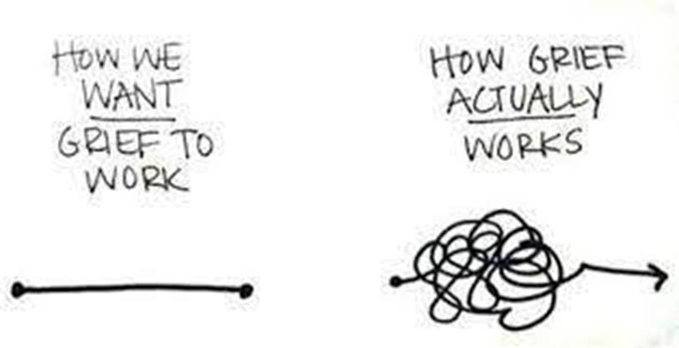
The Ebb and Flow of Grief
Grief does not follow a straight line or “stages”
Ups and downs are natural and to be expected
There is no “closure” or “getting over” grief – grief does not come to an end, it just changes over time, and becomes a new normal
(Canadian Virtual Hospice, n.d.)
Adapted for use by:
Notes:
Facilitator notes: Grief is messy. You don’t know when those intense moments of grief hit.

Slide 8
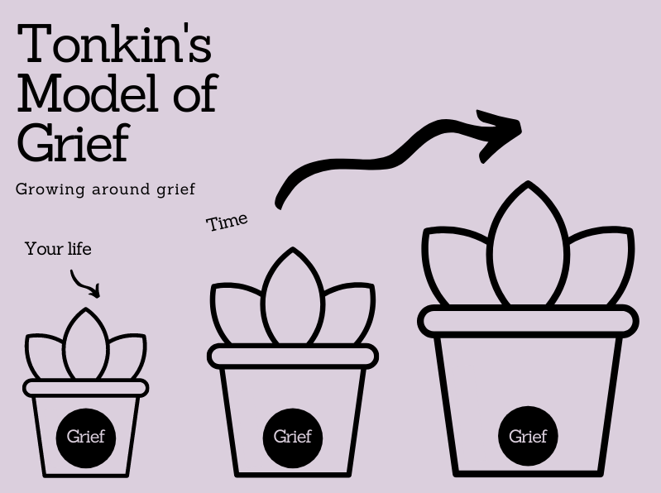
Model developed by grief counsellor Lois Tonkin
Grief itself does not shrink or disappear
Life gradually grows around grief
Intensity of grief may resurface at times, as strong as the beginning
With time, life can be lived in the space around grief
A new life that includes the loss
Adapted for use by:
Notes:
Facilitator Notes: Create some conversation around the picture – when you see this, what do you interpret? How might you create understanding with the family you support? Loss becomes apart of life.

Slide 9

Understanding the experience of grief
Intuitive grief – experienced with feelings and emotions
Grief is experienced in waves of emotion
Grief expression mirrors inner feelings and emotions
More feeling than thinking
Focused on exploring and expressing feelings and processing emotions
Instrumental grief – experienced in more cognitive and physical ways
May take more of a problem-solving approach
Direct their energy into activities
Grief is expressed in more physical, cognitive or behavioral ways
More thinking than feeling
Focused on doing and actively responding to grief
(Grief & Loss Center, n.d.)
Adapted for use by:
Notes:
Facilitator: Add a story from practice that reflects these types of grievers. Remember it can also be a combination.

Slide 10
How to Show your Support
Make comments and questions in a compassionate and sensitive way – allow opportunity for the grieving person to express themselves
Use the following conversation prompts:
  “It sounds like your partner was a very special person. You must have shared many memorable times together”
  “What is your biggest concern or worry right now and can I help you?”
Adapted for use by:
Notes:
Facilitator Notes: Again, emphasis on compassion – “Response that is empathetic, but it adds an action”. It does not have to be a huge action – can be a gesture –hand on shoulder, a telephone call or just a simple phrase of “can I help you?” – even if the answer is “no” – this will display compassion.
Listen 99% of the time, don’t do all the talking!
Provide some prompts – talking to someone, providing local resources, explore whether open to attending grief support or someone to call. Remember if many services and people were in place to support, caregiver may feel abandoned when everyone leaves.

Slide 11
What not to say……
“They lived a good, long life”
“Call us if you need anything”
“They are in a better place now”
“Time heals all wounds”
Barriers to trust:
  Making assumptions about how the person is feeling or stating that you know how they feel; offering platitudes
  Rushing and conveying impatience or a lack of time
  Talking over someone; conveying a sense of judgment
Adapted for use by:
Notes:
Facilitator Notes: Allow for discussion - What have you heard that has not been helpful? What Barriers to trust have you experienced or witnessed? If there is no discussion – add in animated comments.
What can we say instead? “I can’t imagine what you’re feeling right now/going through…. Provide an invitation…..”can you tell me more? I’d like to support you”.

Slide 12


What to Expect When Grieving
Emotional
Feeling overwhelmed or numb
Guilt and Anger
Emotional triggers
Physical
Disturbed sleep patterns
Change in appetite
Anxiety or hyperactivity
Weakened Immune system
Social
Social Withdrawal
Decreased productivity at work or school
Lost of interest in usual hobbies
Adapted for use by:
Notes:
Facilitator Notes: Caregivers can be on “autopilot” – taking the time to notice and provide care will be important. Bring a little discussion forward based on the picture. Normalize the experience for them by letting them know they might experience these things.

Slide 13

When to Get Extra Support
Persistent depression or anxiety
Inability to function day-to-day
Substance misuse
Feeling stuck or lost
Isolation or despair
Adapted for use by:
Notes:
Facilitator Notes: Your role might include connecting and referring to specialists/clinicians. They might not be in a space to do this by themselves. You may need to help them by connecting and referring on their behalf.

Slide 14
Adapted for use by:
Notes:
Facilitator Notes: Bereavement wrap up summary – take a moment to tie in material and discussion throughout the module.

Slide 15


Our Learning Journey
Supporting Self-Care
Supporting Bereavement
Supporting a Pronouncement
Supporting Anticipatory Grief
Notes:
Animation - Give preview of the next module: Supporting Self-Care. As we finish, the key takeaway is this: understanding the what is important but mastering the how is what drives impact.
Thank everyone and close.

Slide 16
References
Canadian Palliative Care Nursing Association. (2024, September). Position statement: Grief and grief literacy. Canadian Palliative Care Nursing Association. https://www.cpcna.ca/_files/ugd/67b8a1_1de1656e4b4f4ad0bfec9c5a0f854630.pdf
Canadian Virtual Hospice. (n.d.). Grief training for healthcare professionals. Canadian Virtual Hospice Learning Hub. Retrieved September 10, 2025, from https://www.virtualhospice.ca/learning-hub
Cruse Bereavement Support. (n.d.). Growing around grief. Retrieved September 30, 2025, from https://www.cruse.org.uk/understanding-grief/effects-of-grief/growing-around-grief/
Grief & Loss Center. (n.d.). Continuum of grief. Retrieved September 30, 2025, from https://mygriefandloss.org/continuum-of-grief
Adapted for use by:

