Slide 1
Kick off: The Art of the Visit – Supporting Grief Work
Welcome and Purpose
Introductions
(Small groups of 10-12)
Case Study:
Think-Pair-Share
Initial Engagement Take-away
Adapted for use by:
Notes:
Facilitator Notes:
Welcome and Purpose:
Senior Leadership: Share the “why” – why this learning matters and how it connects to the mission of the organization
Learning focus: Explore how presence, empathy and meaning-making shape effective grief support.
Introductions
Icebreaker: “What’s the most exciting or most meaningful thing you’ve done”? – get individuals to share and then identify common themes – draw out the “why” behind what gives your work and life meaning.
Challenge exercise – building on your reflections, take a few minutes to write:
In 3 sentences: What’s most important to you about being present with others in times of grief?
In 2 sentences: Why is that important -to you and to those who you serve?
Case Study: Anticipatory Grief
Review a short scenario on anticipatory grief. For example: Maria has advanced cancer and is receiving Palliative Care Support. She continues to talk about future plans and “getting better”. Her husband Luis stays quiet and says he “needs to stay strong for his wife”.
Think-pair-share: Reflect, discuss key insights, and identify meaningful approaches to support
Initial Engagement Takeaway
Hopefully, attendees are beginning to shape their own ideas about “the art of the visit” – finding connection, purpose, and compassion.

Slide 2
Grief, Loss and Bereavement – “The Art of the Visit”
Module One: Anticipatory Grief
Alisha Leventis, RN, BScN, MN, CHPCN (c)
Palliative Clinical Coach Windsor-Essex
Acknowledgements:
Grateful appreciation to Maureen Collins, Nancy Adams, Grant Goddard, and Diane Russett for their shared insights
Adapted for use by:
Notes:
Facilitator Notes: We are here today as we all have a role in a patient and family’s journey. We are showing up, because we care. Our hope is that you take away one intention/one tool or one idea that will influence your practice moving forward. “Just as ripples spread out when a single pebble is dropped into water, the actions of individuals can have far-reaching effects” – Dalai Lama

Slide 3

Supporting Anticipatory Grief Work
Anticipatory Grief – The emotional response to an impending loss, occurring before the actual loss happens
Adapted for use by:
Notes:
Facilitator Notes:
Share a story of anticipatory grief – includes functional losses and more well before death occurs. How does the person and family move through these losses?
56-year-old male with metastatic cancer. Married and father of 3. Recently had to give up his job due to increasing fatigue. Ambulatory but increased peripheral edema with significant weeping – makes distance and stairs challenging. Starting to need assist with dressing and showering.

Slide 4
Is there a Role for Nurses in Supporting Grief Work?
In caring for people and families at end of life, nurses form close relationships that give them a unique perspective on grief
Nurses do provide grief support within their scope of practice
Grief is not only about death
People may grieve lost abilities, roles or activities
Caregivers may grieve roles and relationships that have changed
(Canadian Palliative Care Nursing Association, 2024)
Adapted for use by:
Notes:
Facilitator Notes:
Start with the initial question: Is there a role for nurses in supporting grief work? – allow discussion around initial question (then enter statements – see if it matches group responses or are there other responses not considered that are appropriate?)
Review that it is within scope of practice
Nurse are walking into situations where grief is already present – how do we support and move through as providers?

Slide 5
Getting Comfortable with the Uncomfortable
Reviewing and revisiting goals of care can be challenging for providers
Delivering truth gently and compassionately is an essential part of this process
(Canadian Palliative Care Nursing Association, 2024)
Adapted for use by:
Notes:
Facilitator notes: Allow time for discussion – what makes you uncomfortable? What are you afraid of?
Do you find yourself thinking of a response instead of listening and being present in the moment?

Slide 6
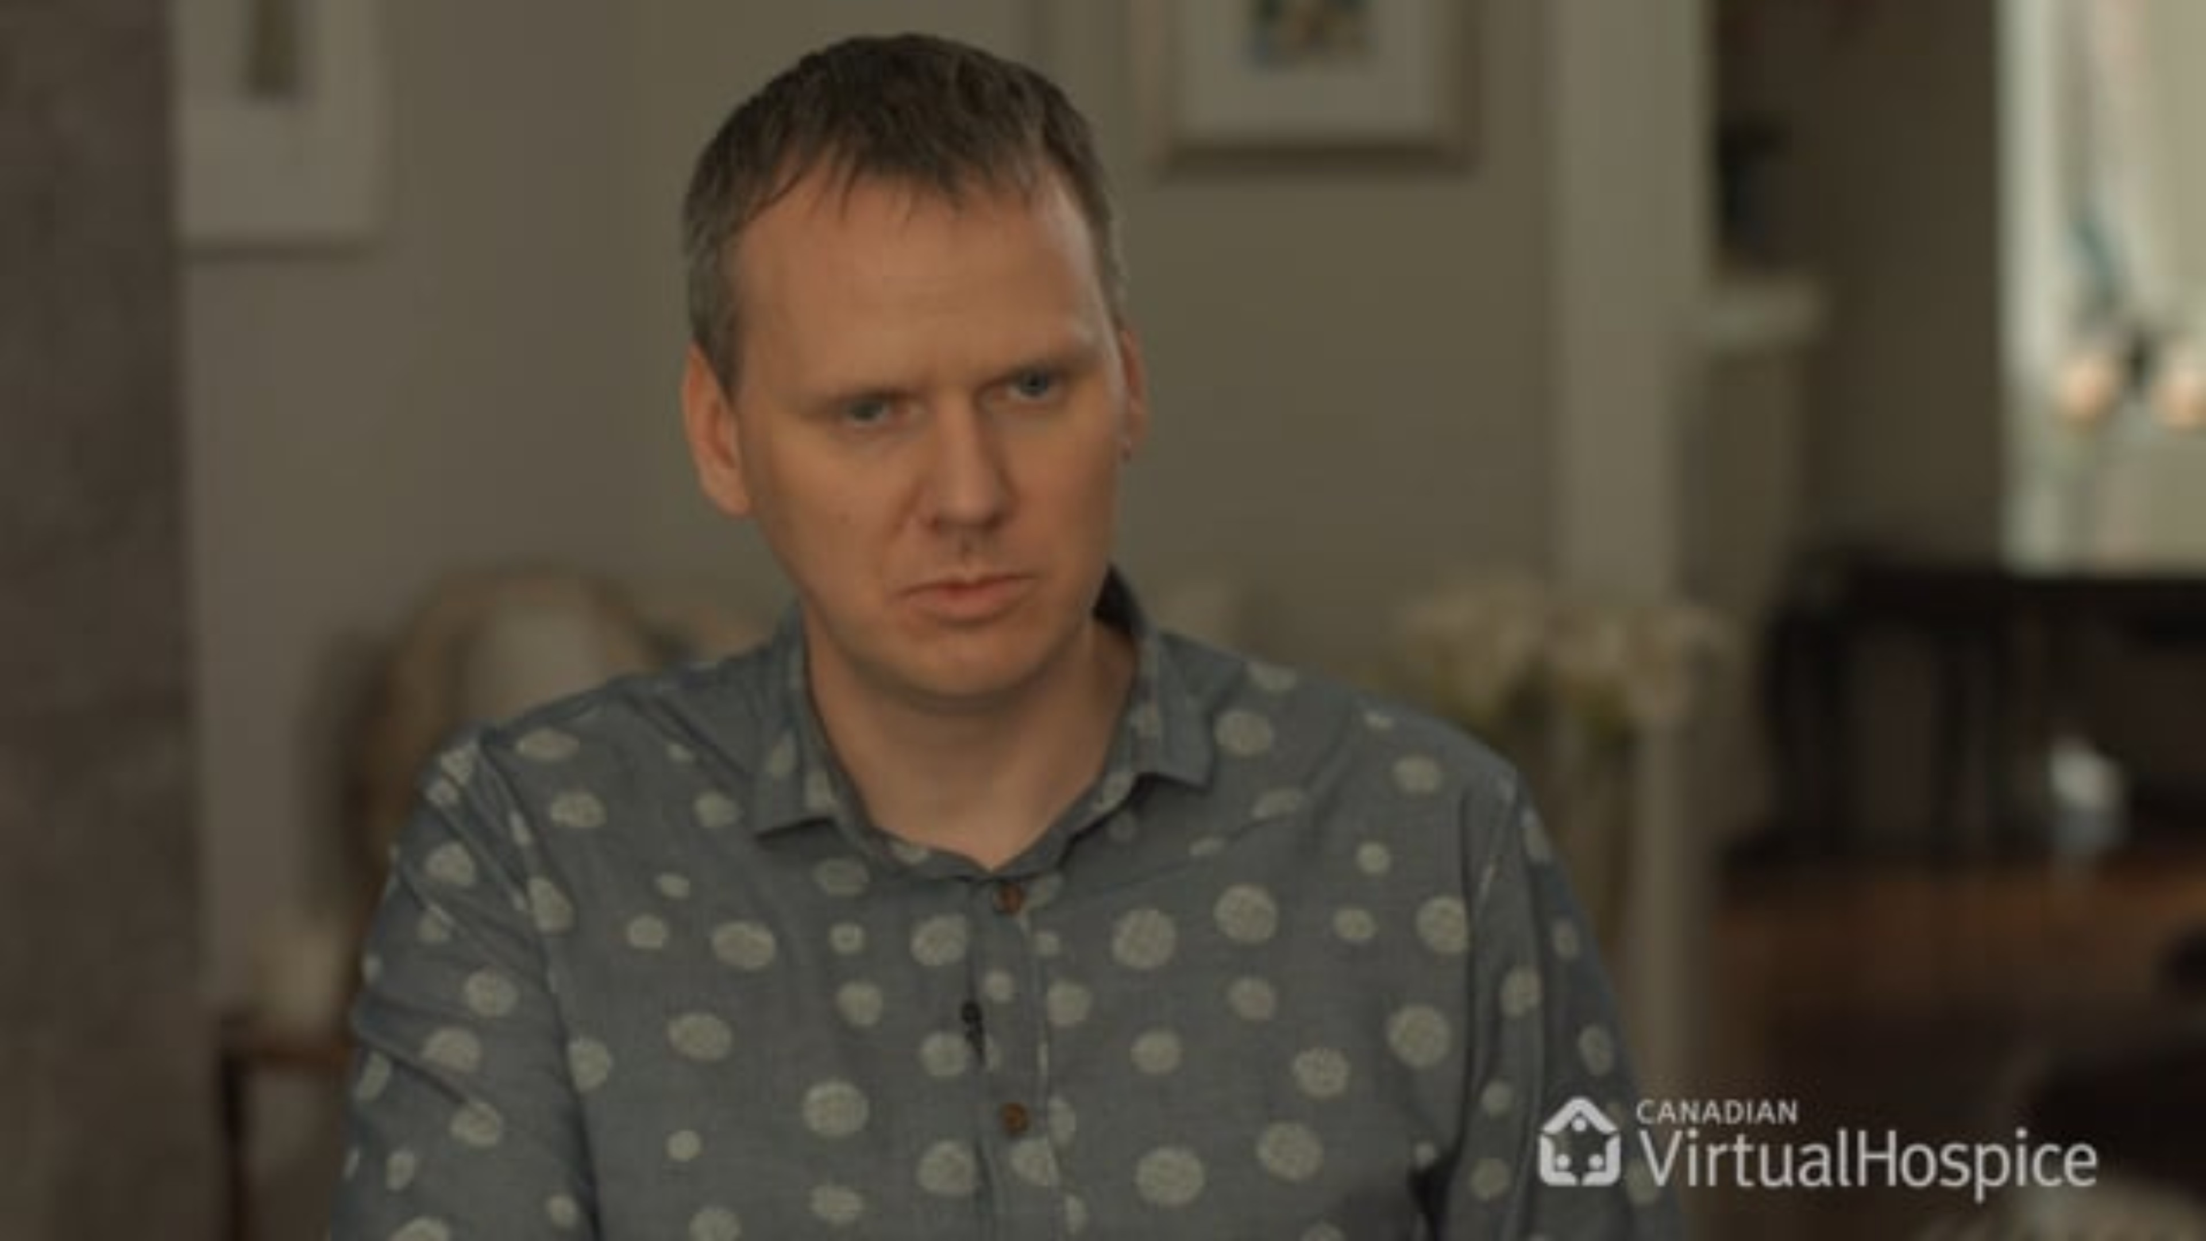
Notes:
Facilitator notes:
Add a minute or two to pause and reflect based on the video. Does this ring true for attendees?

Slide 7
Importance of Compassionate Truth-Telling
Aligns patient priorities and health expectations with their wishes
Patients and families experience less distress, confusion, and fear
Benefit of nurse-led conversations have been noted to reduce the patient’s decisional conflict and optimize the documentation of EOL care preferences
(Cretu, Torabi & Stilos, 2023)
Adapted for use by:
Notes:
Facilitator notes:
Keep the words on the slide but put the meaning behind it – what is the message? Supporting someone as illness advances means exploring how will we support as needs change? What does a good day look like and how can we adjust and support to ensure that we can create that good day ongoing even when it “looks different” based on function change. This will ensure that care is always matching the wishes of the patient. Families also become empowered – they are aware of the changes and how to support as they changes occur. It is taking away the “fear of the unknown”.
Bottom line: How do we work around limitations? We cannot change the outcome, but we can affect the journey!!!!

Slide 8
Communication Support Frameworks
N-U-R-S-E-S
N – Name the emotion. Gently identify the feeling you’re noticing. “It sounds like you’re feeling overwhelmed”…
U – Understand and acknowledge. Show empathy by recognizing the situation and its emotional impact. “This must be incredibly difficult for you”…
R – Respect and recognize efforts. Acknowledge the strengths, values or actions of the person or family “You are providing excellent care at a difficult time”
S – Support and reassure. Let them know they’re not alone and that you’ll be there for them – “We will do everything we can to support you through this process”
E – Explore with curiosity. Invite them to share more about their feelings or experiences. “Would you feel comfortable telling me more about how you are feeling”
S – Silence. Allow quiet moments to hold space for reflection and presence. Sometimes silence can be more powerful than words!
(Childers, Bulls, & Arnold, 2023)
Adapted for use by:
Notes:
Facilitator Notes:
We want to be able to provide tools to help you build your support. We will share 4 communication frameworks that you can use. Choose one or a combination that “speaks to you” and try them out in practice.
Demonstrate briefly the use of one framework - pick the one you are most comfortable using or that you use in practice.

Slide 9
Communication Support Frameworks
Wish – Worry – Wonder
“I wish” phrases help show empathy and connect with the person’s hopes or goals, even if they may not be fully achievable
“I worry” allows you to express honest concern while being gentle and respectful
“I wonder” is a thoughtful way to suggest a new idea or gently encourage deeper conversation
(Ariadne Labs, 2023)
Adapted for use by:
Notes:
Facilitator Notes: Can be useful when “hitting a brick wall” when trying to communicate. It is a softer approach to align with your patient’s hopes.

Slide 10
Communication Support Frameworks
ASK-TELL-ASK
Ask – Start by understanding what the person already knows and what they would like to know. “Can you share what you understand about what’s happening right now”?
Tell – Share important information clearly and simply. Keep it brief and avoid medical jargon. Use short sentences and pause to check for understanding.
Ask – Invite them to explain back what they heard, in their own words, to ensure clarity. “Just so I know I explained it clearly; can you tell me in your own words what you took from that?”
(CAPCE, 2020)
Adapted for use by:

Slide 11
Serious Illness Conversation Guide
Developed by palliative care experts; language tested by patients
Encourages more frequent, earlier, and higher-quality conversations with patients
Focuses on patient’s goals, values and priorities for care
Guides future care planning
Easy to use framework for all clinicians
Adapted for use by:

Slide 12
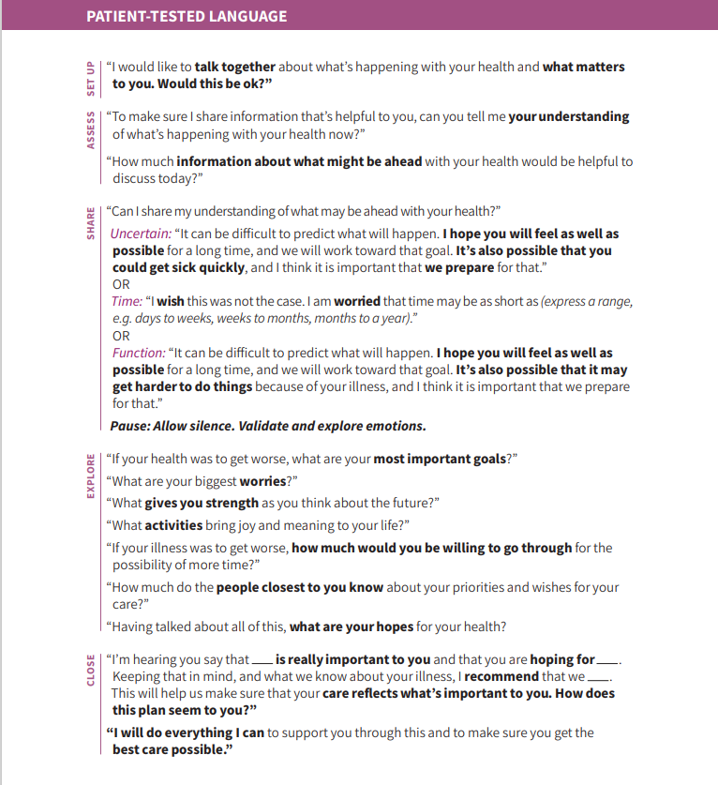
Serious Illness Conversation Guide
(Ariadne Labs, 2023)
Adapted for use by:
Notes:
Facilitator notes:
This is a busy slide – the handout is in your package to review. Again – use what works for you and feels comfortable in conversation. I would like to point out that this framework also recognized the strengths of the patient – What gives you strength as you think about the future? Often, we look at a situation from a “problem perspective”, especially as nurses…..but it’s important to sometimes look at a situation from a “strengths” perspective and build on that to provide support.

Slide 13
Examples of Conversation Prompts
“What is your understanding of what is happening with your illness?”
“At the moment, things are uncertain, have you thought about what might happen if you became more unwell?”
“I am concerned that your illness is worsening faster than we were expecting. I’d like to talk about what we are seeing. Are you comfortable with me doing that now or are their others in your family that you would like with you?”
“If you become too sick to make decisions, who will do this for you?”
“Let’s hope for the best, but is it ok if we make a plan for the rest?”
(Ariadne Labs, 2023; Canadian Virtual Hospice, n.d.)
Adapted for use by:
Notes:
Facilitator Notes:
Start by exploring if there are conversation starters or prompts that the attendees already use to further explore with patients and families. Then fade in one conversation prompt at a time – this way the group can learn from each other!!

Slide 14
Words Matter
The way people receive difficult information and the support they receive at that time can have an impact on their grief
The tone used and non-verbal cues are important
Prepare yourself
Speak honestly and with sincere plain language
Check in to assess how well they understood
Use silence – it allows others to process the information and respond
(Canadian Virtual Hospice, n.d.)
Adapted for use by:

Slide 15
Beyond Fixing: Being Present to Suffering
Nurses are trained to identify and solve problems, however at the end-of-life, emotional and spiritual distress is not a problem to be solved
Patients often need someone to simply be present rather than trying to provide answers
Compassionate listening can be more powerful than action
Presence creates space for meaning-making and personal insight
(Tornoe, K.A., Danbolt, L.J., Kvigne, K. et al. 2015)
Adapted for use by:
Notes:
Facilitator Notes:
Our clients and families are broken – “ripped apart” – but this cannot be fixed. It is not something that can be “put back together” and it is not a problem to be solved. Just be present and bear witness to the suffering. Tears are ok, as long as you as a provider are not the one needing the comforting! Allow yourself to be “human” in that moment. Be comfortable sitting in silence and provide a listening ear – this does not take extra time – it just creates quality time!

Slide 16
Communication in Moments that Matter
Take a moment to reflect on a time when you received difficult or life-changing news.
What do you remember most about how the information was shared?
How did the communication — the words, tone, setting, or the person delivering it — impact your understanding, emotions, or next steps?
What might have helped you feel more supported in that moment?
Adapted for use by:
Notes:
Facilitator Notes:
Focus on the last question for group expression – What might have helped you feel supported in that moment? This will create meaning in their own experience and then hopefully influence how they practice.

Slide 17

Using Validation
Consider how you can validate the person’s experience and acknowledge their suffering. Describe what that might look like.
Adapted for use by:
Notes:
Facilitator notes:
Allow opportunity to “Think, Pair and Share”
Conversation prompts that demonstrate validation – for use to generate discussion but first allow opportunity from the group.
“I can imagine everything is overwhelming for you right now. Who or what are your main supports right now?
“This is a tough time for you – perhaps the toughest thing you have ever gone through. I have had the honour of working with a lot of families at very difficult times like this. I have learned there is no “right way” to go through it.
“You are providing excellent care and support for ……right now” (remind them of their strengths and/or provide reassurance)

Slide 18

Remember:
BIG emotions are ok – give people time and space to spontaneously feel. You don’t need to know what to say, stay calm and offer your presence.
Don’t stop emotional reactions by speaking up or offering tissues, give the safe space to allow the emotions to occur
(Canadian Virtual Hospice, n.d.)
Adapted for use by:
Notes:
Facilitator notes: Handing someone a tissue can sometimes signify (unconsciously) to that person that they should stop crying. Allow the safe space for emotional reactions. You can have a Kleenex box in the room, but don’t hand the tissues over unless asked.

Slide 19


When we are with a patient who is suffering and dying, we should never lose sight of the fact that it is their own death that they are facing and no one else can do this for them. It is “their journey”.
Notes:
Facilitator notes:
It is not your job to “fix” the journey. Use this to generate a final group discussion – draw out experiences. Share brief story: Someone who choose to stay home for end of life, structurally vulnerable, active substance misuse from housemates. Challenging to support care and symptom management. Walking away knowing unsafe and vulnerable. Yet it is their choice – people choose the way they live and choose the way they die.

Slide 20
Adapted for use by:
Notes:
Facilitator Notes:
Anticipatory Grief Wrap up Summary – bring it back to the beginning and tie the material together based on participation throughout the module.

Slide 21

Our Learning Journey
Supporting Bereavement
Supporting a Pronouncement
Supporting Anticipatory Grief
Notes:
Animation - Give preview of the next module: Supporting Grief During a Pronouncement and Supporting Bereavement. As we finish, the key takeaway is this: understanding the what is important but mastering the how is what drives impact.
Thank everyone and close.

Slide 22
References
Ariadne Labs. (2023). Serious illness conversation guide (Version 05-18-2023) [PDF]. https://ariadnelabs.org/wp-content/uploads/2023/05/Serious-Illness-Conversation-Guide.2023-05-18.pdf
Ariadne Labs. (n.d.). Serious illness care. https://www.ariadnelabs.org/serious-illness-care/
Canadian Palliative Care Nursing Association. (2024, September). Position statement: Grief and grief literacy. Canadian Palliative Care Nursing Association. https://www.cpcna.ca/_files/ugd/67b8a1_1de1656e4b4f4ad0bfec9c5a0f854630.pdf
Canadian Virtual Hospice. (n.d.). Grief training for healthcare professionals. Canadian Virtual Hospice Learning Hub. Retrieved September 10, 2025, from https://www.virtualhospice.ca/learning-hub
Childers, J. W., Bulls, H., & Arnold, R. (2023). Beyond the NURSE acronym: The functions of empathy in serious illness conversations. Journal of Pain and Symptom Management, 65(4), e375–e379. https://doi.org/10.1016/j.jpainsymman.2022.11.029
Comprehensive Advanced Palliative Care Education (CAPCE) Program
Cretu, E., Torabi, S., & Stilos, K. (2023). Palliative care advanced practice nurse role in engaging in serious illness conversations. Canadian Oncology Nursing Journal, 33 (3), 377-382. https://doi.org/10.57307/2369-2895.1354
Tornoe, K.A., Danbolt, L.J., Kvigne, K. et al. The challenge of consolation: nurses’ experiences with spiritual and existential care for the dying-a phenomenological hermeneutical study. BMC Nurs 14, 62 (2015). https://doi.org/10.1186/s12912-015-0114-6
Adapted for use by:

