Slide 1
Grief, Loss and Bereavement –
“The Art of the Visit”
Module Four: Supporting Self-Care
Alisha Leventis, RN, BScN, MN, CHPCN (c)
Palliative Clinical Coach Windsor-Essex
Acknowledgements:
Grateful appreciation to Maureen Collins, Nancy Adams, Grant Goddard, and Diane Russett for their shared insights
Adapted for use by:
Notes:
Facilitator notes: Refer to previous modules – recap (include participation remarks – perhaps have flip chart sheets posted – to demonstrate how far we what come and provide intro this module.

Slide 2
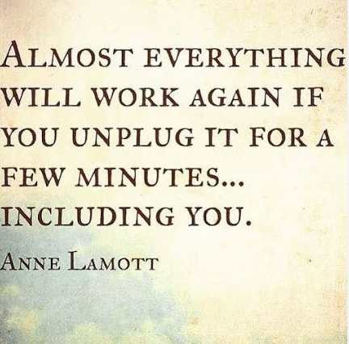
Adapted for use by:
Notes:
Facilitator notes: Isn’t this so true. When there are pumps that are alarming, or our TV/computer aren’t working quite right – we shut it down and re-boot it. We need to start doing this with ourselves!

Slide 3

Think, pair and share
What emotions or stresses tend to stay with you after a difficult visit, and how do you notice the impact – physical or emotional?
What personal practices or boundaries have helped you recover or stay grounded after emotionally heavy work – and what makes self-care challenging at times?
What kinds of support – from colleagues, teams, or the organization – help you sustain your well-being when working with grief, loss, and bereavement?
Adapted for use by:
Notes:
Facilitator Notes: Refer to the picture – sometimes we pay attention to only the surface of an individual – we say the “pat” answers “I’m fine” – but what's reflected below the surface?
Facilitators will need to ensure everyone is being seen and heard throughout the modules – referring to previous comments/discussions.
Leadership support is important here – what is our commitment to supporting self-care?
What ideas for small impactful change could be accomplished given the realities of our work settings – open discussion based on last question.

Slide 4
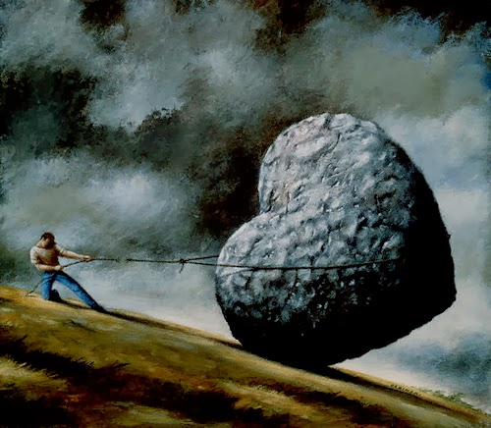
The Hidden Weight of Professional Grief
Health care workers experience emotional distress from repeated exposure to patient death
Professional grief is often overlooked and under-supported
Encounters with suffering, death, and dying are psychologically demanding, yet not consistently recognized as workplace exposures
(Phillips et al., 2025; Uguz et al., 2025)
Adapted for use by:
Notes:
Facilitator Notes: Grief work is heart work - it can feel so heavy – like a large stone we carry around. A study looking at the Grieving Process for Nurses noted 85% of nurses experienced significant emotional distress, 70% reported impaired work performance, and 60% utilized some form of support or coping strategy.

Slide 5
Understanding Grief in Care Work
Many healthcare workers feel unprepared to manage professional grief due to:
  Lack of formal education on bereavement, and grief processing
  Lack of knowledge or strategies for self-care
  Difficulty with communication with dying patients and their families
  (Philips et al., 2025)
Adapted for use by:
Notes:
Facilitator Notes: Any “safety nets” – mechanisms in place? As nurses, we can’t see our own stress or behavior in ourselves in order to respond. We aren’t trained as counsellors and we can’t counsel ourselves. Everything we do everyday takes a toll.
We need to enter this very vulnerable space and encourage sharing – “I’m really worried about you” – ensure this space is protected and safe.
Talking to people who understand and working with people who have had this experience can be a source of informal support.
As healthcare providers we can be traumatized by witnessing someone’s dying journey – we talked about this in anticipatory grief – witnessing all those losses before someone dies.

Slide 6
Understanding Grief in Care Work
Grief is a universal human experience and a natural response to loss
For health care workers, grief may stem not only from patient deaths but also from witnessing suffering and illness-related losses
Even brief relationships can create deep emotional bonds, influencing the intensity of grief
Grief can also foster growth – bringing meaning, deeper connections, and post-traumatic resilience
(Philips et al., 2025)
Adapted for use by:
Notes:
Facilitator Notes: “There are days when their grief settles into you. Like a stone in deep water – silent, heavy, pulling at the parts of you. You keep steady for everyone else. And still, you return. Not because the weight is light, but because love, in its truest form, is the courage to shoulder what another cannot carry alone”. (Author – Unknown). Read this short excerpt to begin discussion around professional grief. What are your experiences in the community?
Journeying with.....
Supporting with.....
Advocating with....
Our patients and families can feel helpless without our help to navigate them through – “what to expect”
We see and witness the struggle – our patients’ loss of a job/work; loss of a role etc. Having to accept help and equipment (hospital bed/commode etc.)

Slide 7
Understanding Grief in Care Work
Concept of “good death versus bad death”
  Good deaths: Minimal suffering, patient wishes respected, unnecessary treatment avoided, home-like setting = emotional relief and meaning for staff
  Bad deaths: Prolonged suffering with no effective treatment to offer = guilt, powerlessness, and emotional burden for staff
  (Phillips et al., 2025)
Adapted for use by:
Notes:
Facilitator Notes: Allow for discussion around what nurses consider “a good death” – what does this look like to them? Contrast to what nurses perceive “a bad death” looks like. Animations for what research supports. See how closely the comments matched. What can we add to these from practice?
Good death – “Happens just they way they want, when they want”. They were given a chance for closure. A chance to say good-bye. Family around them.
However, we must realize our own biases as to what we consider a good vs. bad death. We might think a transfer at PPS 10% out of hospital might be a bad death, but to that person and family that were able to be at home, that might be a good death. This is why it is important to ask ahead: What is important to you? What would you be willing to go through for more time/time at home etc. What would you rather have.....
Bottom line: What is suffering for them. These questions can improve communication and trust with patients and families – check in with them.

Slide 8
The Cost of Unacknowledged Grief
Professional grief is often seen as “part of the job”, making it difficult to process
Without time or space to grieve, health care workers risk developing complicated grief
Workers must balance their own grief while continuing to provide care, increasing vulnerability to compassion fatigue
Compassion fatigue can lead to:
  Emotional numbness
  Absenteeism or presenteeism
  Workforce turnover
  Depression, anxiety, PTSD, insomnia
  Declining physical health
  (Phillips et al., 2025)
Adapted for use by:
Notes:
Facilitator Notes:
Define presenteeism: Lacking the conditions to be fully present at work. Our bodies are present at work and going through the motions/tasks, but we have “checked out” – the need for rest and leave for various reasons
Discuss “putting a box around it” – still doing the job – never opening it can lead to compassion fatigue. We need to box it then unbox it and work through it when we have space and time to do this.
“Unboxing” – Do we have the motivation, means and opportunity to do this? Are we in a safe place?

Slide 9
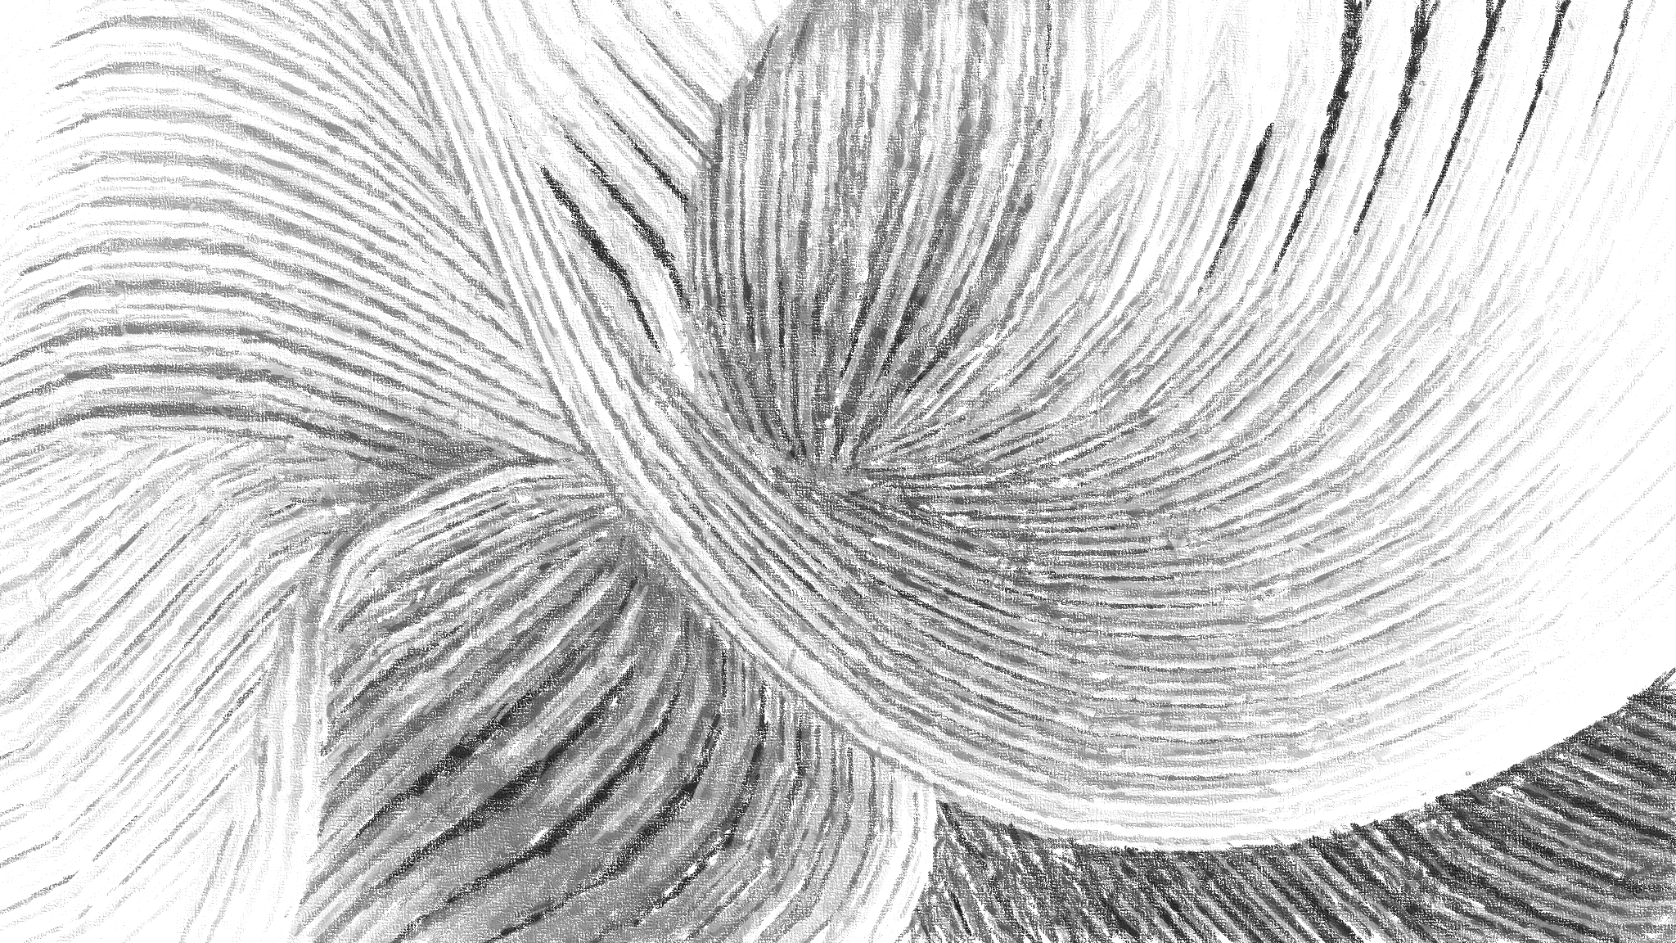
Culture and Stigma Leads to Unacknowledged Grief
Culture of Healthcare
Heavy workloads, understaffing, and the pressure to quickly transition to the next patient hinders ability to process grief, leading to emotional strain
Institutional culture can exacerbate professional grief – “death is part of the job” leading to a culture of silence
Stigma around Grief
Healthcare environment often discourages open expressions of grief, reinforcing a culture of emotional suppression
Grief expression, counselling and de-briefing are sometimes viewed as a weakness or lack of experience
(Phillips et. al.,2025)
Adapted for use by:
Notes:
Facilitator Notes: “This is the current life we live in – how do we deal with it?” We witness the challenges in practice – how do we cope?

Slide 10
Psychological and Physical Impact
Grieving professionals often experience feelings of loneliness, stress, and burnout, along with sleep disturbances, increased blood pressure, chest pain, fatigue, anger, intrusive flashbacks, depression and negative impacts on their personal relationships due to unprocessed grief
Healthcare workers often carry the weight of responsibility and will reflect on what they could have done differently and reviewing whether everything was done correctly, leading to guilt and self-doubt
(Phillips et al., 2025)
Adapted for use by:
Notes:
Facilitator Notes: Open it up for group discussion – what psychological or physical impact do you see/feel while doing this work? Animation for comments from research – again compare with participant answers.
We often find ourselves questioning our actions and interactions, feeling badly if things didn’t go as planned. Some of us have a hard time taking compliments and praises from others – tougher time finding the positives. This is a lack of self-compassion and something we will work on. How can we extend the same compassion to ourselves that we do for others?

Slide 11
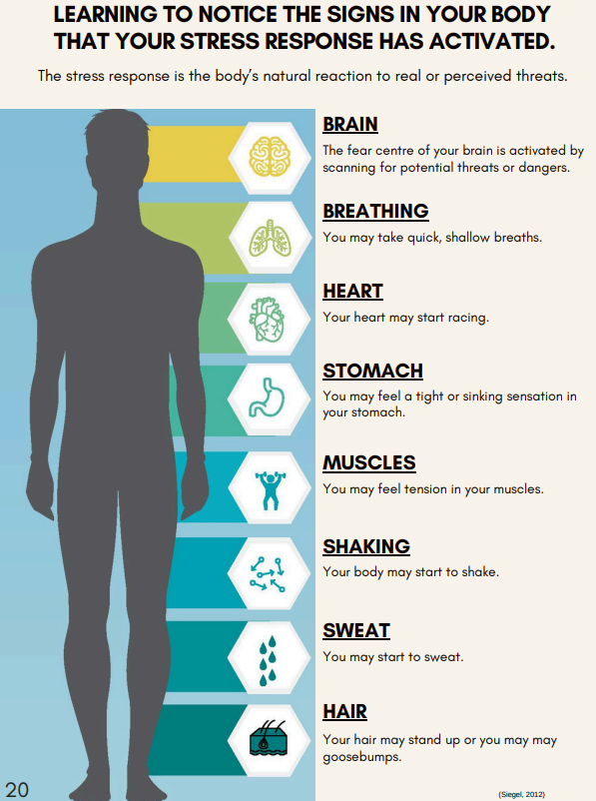
Adapted for use by:
Notes:
Facilitator Notes: Participant manual – Sellf Compassion Guidebook (Champlain Hospice). Provide an opportunity to “Check in” with their bodies – think about a typical workday – what do you feel as you go about your work? Especially when supporting clients at end of life.
“Fight or Flight reactions”

Slide 12
Coping Strategies
Formal support
Informal support
Personal Self-Care and Finding Meaning
(Phillips et al., 2025)
Adapted for use by:
Notes:
Facilitator Notes:
Formal Support: Desired resources include paid time off from work following difficult deaths (younger deaths, unexpected deaths, and prolonged suffering prior to death); designated time and space to grieve at work – start of meetings, take the opportunity to share the names of those clients that have died – share the moment - talk about the stories – who they were as a person; structured debriefings and support groups; and availability of professional grief counselling
Informal Support: Colleagues provide the most meaningful support where shared experiences foster understanding
Personal Self-Care and Finding Meaning: Self-care strategies such as outdoor activities, spending time with pets, or relaxing through music, massages etc.
Remembering deceased patients through personal rituals
Talk about the good/sad/and bad things.
Sharing stories – funny moments – we coach families to do this around the bedside, but do we give ourselves permission to do this?

Slide 13
Unhealthy Coping
Emotional avoidance
  Suppressing or compartmentalizing their emotions
  Negative long-term effects due to not adequately processing grief, including loss of empathy and emotional shutdown both personally and professionally
Alcohol consumption
Binge Eating
(Phillips et al., 2025)
Adapted for use by:
Notes:
Facilitator Notes: Refer to “putting a box around it” – this is the problem when we don’t “open up the box” later!!
We need to deal with those feelings....even if it is quickly – cleansing breath/box breathing etc.

Slide 14

Where do we go from here?
Understand the grieving process to inform effective support
Provide education and supportive interventions to strengthen coping
Promote self-care and teamwork to enhance staff well-being and patient outcomes
Adapted for use by:
(Mir et al., 2024)
Notes:
Facilitator Notes: The 2nd half of our module will be “the work” – we understand the grieving process – now we are going to work on strengthening our ability to cope and work as a team to support each other.
You need to start exercising what you need. No one can do this for you!

Slide 15
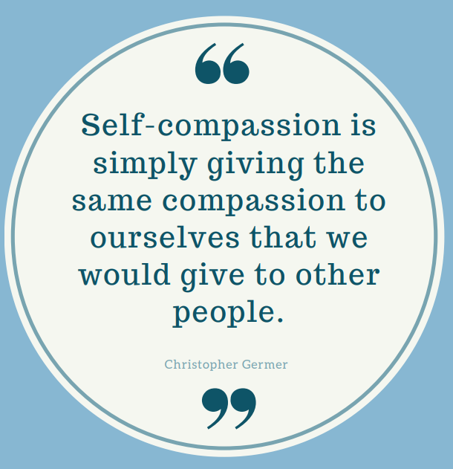
Adapted for use by:
Notes:
Facilitator Notes: This quote comes from the Self-Compassion handbook which we will be using for the 2nd half. It was developed by Champlain Hospice and is a wonderful resource. We will work on a few facilitated exercises from within the workbook today. We have given you the entire workbook to take home for thoughtful review and completion at your own pace.
We need to allow ourselves the counter-balance: See the positives; See your role as spreading hope and happiness in a difficult situation; accept gratitude; accept recognition of achievement. If you start allowing the counter-balance, you will start to feel a sense of fulfillment.

Slide 16
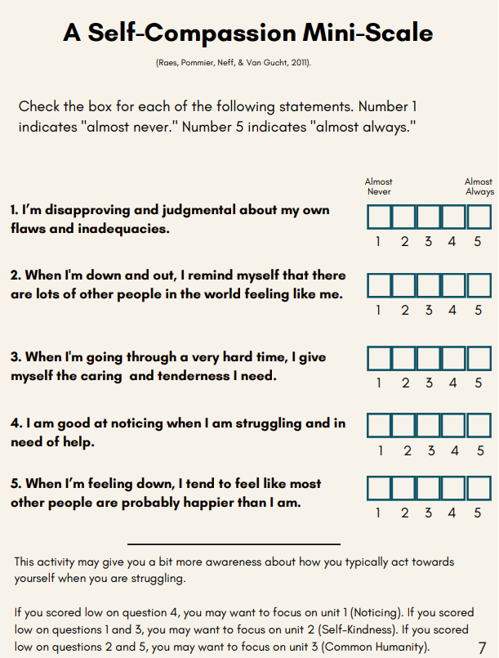
Adapted for use by:
Notes:
Facilitator notes: Can refer to their guidebook in the participant manual to complete. Review the score and the significance per the bottom of this scale.

Slide 17
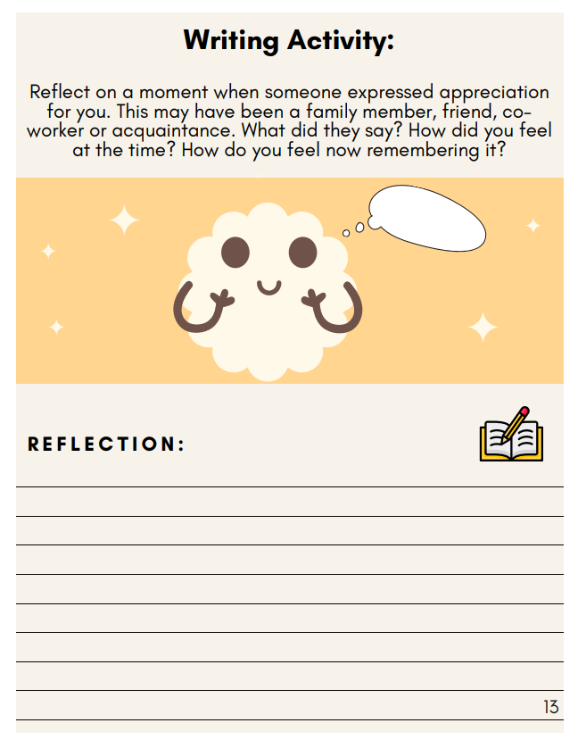
Adapted for use by:
Notes:
Facilitator Notes: “Think, pair and share” activity
When you are struggling, come back to this reflection and think about it.

Slide 18
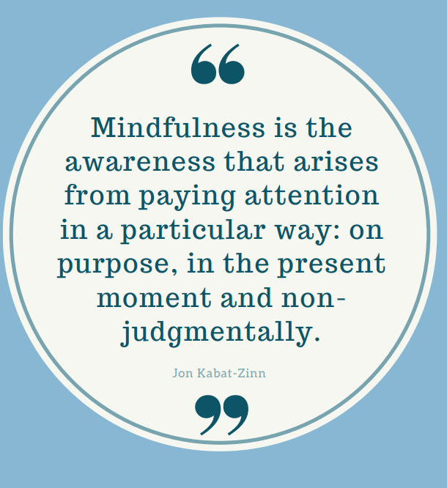
Adapted for use by:
Notes:
Facilitator Notes: Mindfulness invites us to pause long enough to notice what is happening within us – noticing without judgment, without minimizing, and without pushing it aside. When we pay attention in this way, we often become aware of the early signs that we may be carrying too much or beginning to struggle. What indicators have you noticed – in yourself or in others – that might be early signs of struggling? Spend some time here in discussion.
Have you ever gone through a stop sign or red light and thought, wait.....was that a stop sign or a red light? You were just going through the motions with a lack of awareness of your surroundings.
What did I feel? What did I do? Pause long enough to notice what’s happening in us. Clear the chatter and self-talk and check in with yourself.

Slide 19
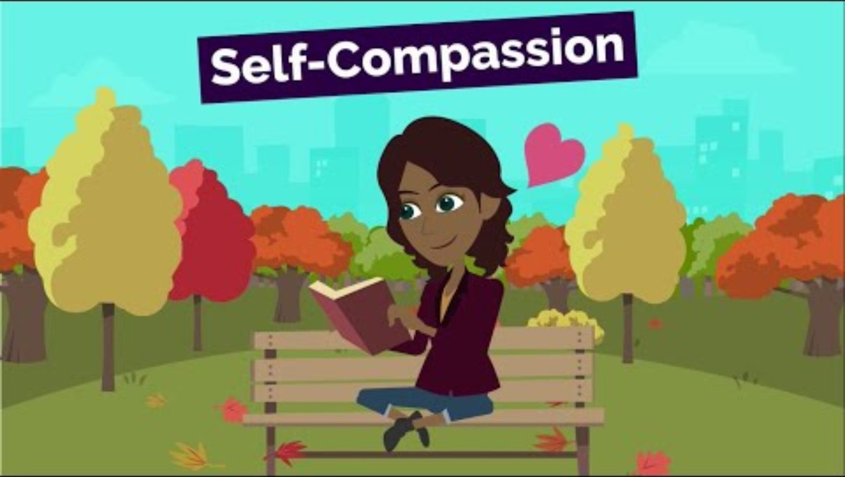
Notes:
Facilitator Notes: Prior to playing the video, thank everyone for sharing. What we just named are the signals that call for something essential: self-compassion. The ability to meet our own suffering with understanding, softness, and support – the same way we show compassion to the people we care for everyday. To explore this, we’re going to watch a short video on self-compassion. As you watch, I invite you to consider: What would it look like if you offered yourself the same gentleness you offer others?
After the video, close with a reflective activity: You’ll create your own six-word story – a phrase, a truth, or a reminder you want to carry with you. You’ll write your six words on a stone. The stone becomes a small anchor – something grounded, steady, and tangible (but not heavy) to remind you of what you chose to hold onto moving forward.

Slide 20
Adapted for use by:
Notes:
Facilitator Notes: Supporting Self Care Wrap up summary. Take some time to tie in material, discussion and activities used throughout the modules. Provide an opportunity for the group to discuss with each other how they will make commitments to each other - how they will support and check in with each other.
Leadership presence at wrap up – how will this be made part of the regular process – formalize it and continue to drive it for sustainability.

Slide 21


Our Learning Journey
Supporting Self-Care
Supporting Bereavement
Supporting a Pronouncement
Supporting Anticipatory Grief
Notes:
Facilitator Notes: Refer to the picture – the rest of the road is hidden – what will be everyone’s next step on their learning journey – what are they taking away? Small intention or practice change or further learning?
Thank everyone and close.

Slide 22

References
Champlain Hospice Palliative Care Program. (2025, June). Self-Compassion Guidebook. Champlain Hospice Palliative Care Program. https://champlainpalliative.ca/wp-content/uploads/2025/07/Self-Compassion-Guidebook-updated-June-2025-1.pdf
Mir, S., Bakht, K., & Shah, S. A. (2024). The grieving process for nurses: A concept analysis. Journal of Health Research Review, 4(2). https://doi.org/10.61919/jhrr.v4i2.1115
Phillips, C. S., Trainum, K., & Thomas Hebdon, M. C. (2025). Hidden in plain sight: A scoping review of professional grief in healthcare and charting a path for change. Health Services Insights, 18, 11786329251344772. https://doi.org/10.1177/11786329251344772
Uguz, O., Ozkol, O., Gungor, D., & Ozcan, Z. (2025). Resilience as a mediator between empathy and professional grief among nurses in high-mortality services. Applied Nursing Research, 85, 152003. https://doi.org/10.1016/j.apnr.2025.152003
Adapted for use by:

